Slide 1
Chapter 16
Death and Dying
Notes:
Add slide notes here

Slide 2
What Is Death? (1 of 3)
Biological death―a complex process
Harvard Medical School (1968)
  Defined biological death as total brain death
  Irreversible loss of functioning in the entire brain
    Higher centers involved in conscious awareness
    Lower centers that control basic life processes

Slide 3
What Is Death? (2 of 3)
To be judged dead:
  Be totally unresponsive to stimuli, including painful ones
  Fail to move for 1 hour and fail to breathe for 3 minutes after being removed from a ventilator
  No reflexes
  No electrical activity in brain

Slide 4
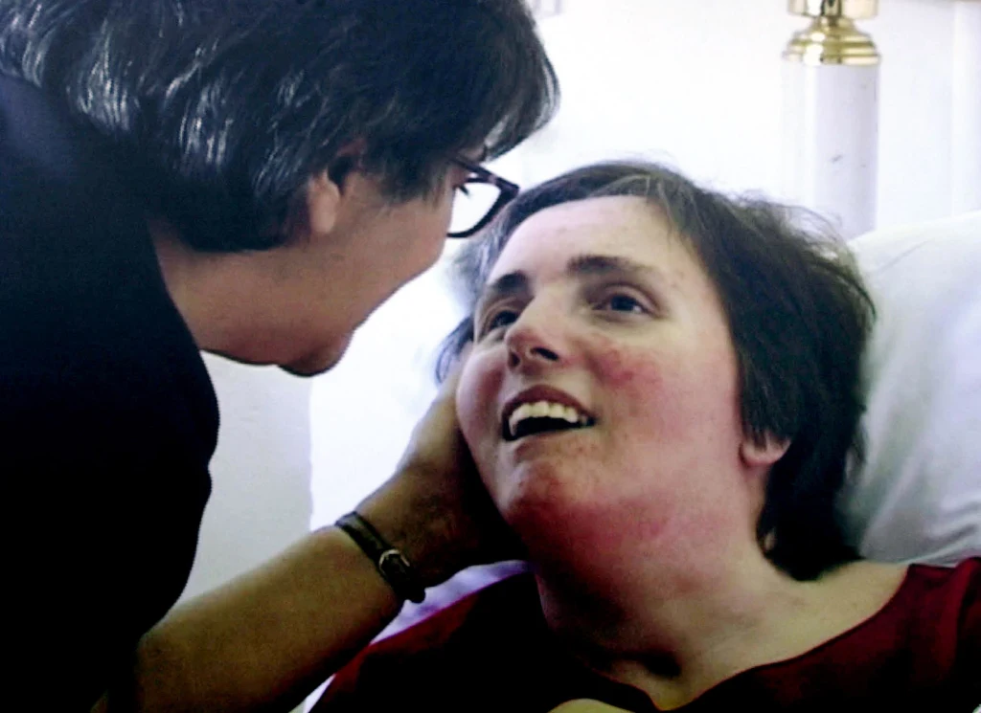
What Is Death? (3 of 3)
Debate about people in comas
  Terry Schiavo case
  Total brain death versus cerebral cortex irreversibly dead
  Persistent vegetative state (PVS): condition in which a person appears awake but is not aware, due to the permanent loss of all activity in the cortex.

Slide 5
Death and End-of-Life Issues (1 of 3)
Advance Directives
  The Patient Self-Determination Act (1990): right of all competent adults to control their healthcare decisions through advance directives.
  Living will: people make known their wishes regarding medical care if they are incapacitated and are unable to speak for themselves.
  Durable power of attorney: individuals authorize a health care proxy to make health care decisions on their behalf if they are unable to do so.
  Only about one-third of adults use an advance directive.
Notes:
LO 16-2: Examine definitions of death and end of life considerations.
C. Advance Directives
a. The Patient Self-Determination Act (1990)—the right of all competent adults to control their healthcare decisions through advance directives such as a living will or durable power of attorney
b. Living will: a legal document that permits people to make known their wishes regarding medical care if they are incapacitated by an illness or accident and are unable to speak for themselves
c. Durable power of attorney: a document in which individuals legally authorize a trusted relative or friend (a health care proxy) to make health care decisions on their behalf if they are unable to do so
d. Only about one-third of adults use an advance directive, including about half of older adults
e. Arguments in favor of all individuals having advance directives (e.g., COVID-19 pandemic)

Slide 6
Death and End-of-Life Issues (2 of 3)
Euthanasia (“easy death”): controversial practice of assisting terminally ill people of dying more quickly.
  Passive euthanasia: withholding/withdrawing of life-sustaining care.
  Active euthanasia: deliberately-induced death.
Physician-assisted suicide: voluntary active euthanasia; terminally ill patients make the conscious decision they want their life to end before dying becomes a protracted process.
  Legal in Canada, European countries, and some states.
  Oregon was the first state to legalize PAS in 1997.
Notes:
LO 16-2: Examine definitions of death and end of life considerations.
D. Euthanasia
a. Euthanasia (“easy death”): Controversial practice of assisting terminally ill people of dying more quickly
b. Passive euthanasia—withholding/withdrawing of life-sustaining care
c. Active euthanasia—deliberately-induced death
d. more than two-thirds of adults and 95% of physicians in the U.S. support passive euthanasia
E. Physician-Assisted Suicide
a. Physician-assisted suicide: a type of voluntary active euthanasia in which terminally ill patients make the conscious decision that they want their life to end before dying becomes a protracted process; patients receive from physicians the medical tools needed to end their lives and self-administer the medication
b. Legal in Canada, several European countries, and several U.S. states
c. Oregon was the first state to legalize PAS in 1997

Slide 7
Death and End-of-Life Issues (3 of 3)
Hospice: end-of-life care that emphasizes dying patients’ needs for pain management, psychological, spiritual, and social support, and death with dignity.
Palliative care: rather than treatment, controlling pain and related symptoms of dying persons.
Home hospice care is associated with increased satisfaction by patients and families.
Notes:
LO 16-2: Examine definitions of death and end of life considerations.
F. Hospice
a. Hospice: an approach to end-of-life care that emphasizes dying patients’ needs for pain management, psychological, spiritual, and social support, and death with dignity
b. Philosophy of the hospice approach emphasizing prolonging quality of life rather than prolonging life
c. Most dying people want to die at home with family and friends
d. Palliative care: rather than treatment, controlling pain and related symptoms of dying persons
e. Services enlisted after the physician and patient believe the illness is terminal and that no treatment or cure is possible
f. Services may be inpatient, at a formal hospice site that provides all care to patients, but are frequently outpatient, in a patient’s home
g. Home hospice care is associated with increased satisfaction by patients and families
h. Patient care team includes physicians, nurses, social workers, and counselors who act as spiritual and bereavement counselors

Slide 8
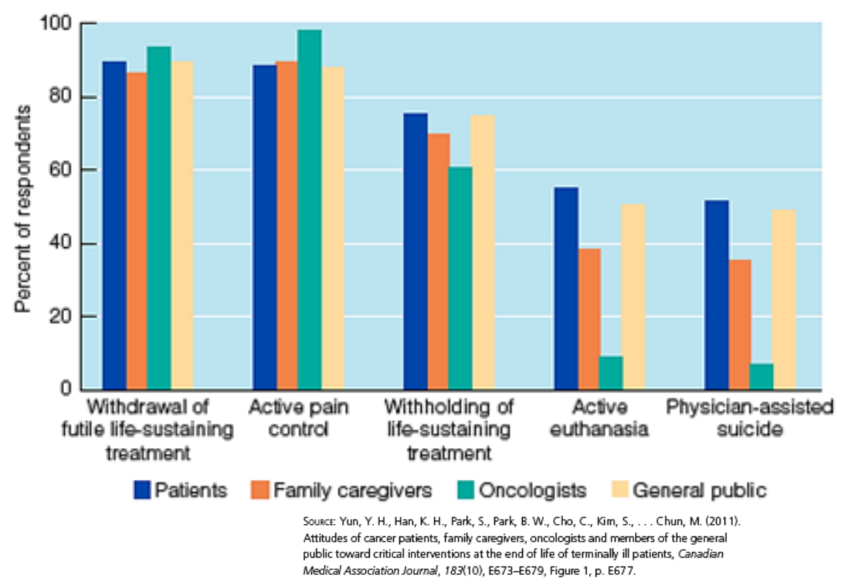
Life and Death Choices
Notes:
Figure 17.1 Percentages of Korean respondents in four groups expressing support for different end-of-life interventions with terminally ill patients.

Slide 9
Social Meanings of Death
Death is also a psychological and social process.
Ariès argues that Western societies:
  Are engaged in denial of death
  Have taken it out of homes and into hospitals/funeral homes
Cultural variations in grieving
  No one right way to grieve

Slide 10
What Kills Us and When? (1 of 3)
The average U.S. citizen born today will live to be about 80.
In 1900, the average lifespan was less than 50.
Advances in medicine and sanitation have extended lifespan by over 30 years.
Notes:
LO 16-1: Identify the leading causes of death and patterns of mortality and life expectancy.
I. Patterns of Mortality and Defining Death
A. The average U.S. citizen born today will live to be about 80; in 1900, the average lifespan was less than 50
B. Advances in medicine and sanitation have extended lifespan by over 30 years

Slide 11
What Kills Us and When? (2 of 3)
In the U.S., mortality has declined by over two thirds between 1935 and 2014.
Fatality in pregnancy and birth for infants and mothers has dramatically decreased.
Racial differences in mortality rates are due to longstanding lack of access, racism, and discrimination.
COVID-19 contributed to a decline in life expectancy.
Notes:
LO 16-1: Identify the leading causes of death and patterns of mortality and life expectancy.
C. Mortality and Life Expectancy
a. In the U.S., mortality across all ages declined by over two thirds between 1935 and 2014
b. Women are less likely to die in childbirth, infants are more likely to survive their first year, children/adolescents are more likely to grow to adulthood, adults are likely to overcome conditions that were once fatal
c. However, the mortality rate for Black infants is more than twice that of Hispanic and non-Hispanic white infants; due to longstanding lack of access and cumulative effects of racism and discrimination
d. Black men also have a lower life expectancy than white and Hispanic men
e. COVID-19 contributed to a decline in life expectancy; people of color were most vulnerable to mortality

Slide 12
What Kills Us and When? (3 of 3)
Leading cause of death
  Preschool and school children: unintentional injuries (car accidents)
  Adolescence and early adulthood: accidents (especially car accidents), homicides, and suicides
  45–64 age group: cancers
  65 years and older: heart disease

Slide 13
Theories of Aging: Why Do We Age and Die?
Programmed theories
  Propose that aging follows a predictable genetic timetable
Damage theories
  Call attention to more haphazard processes that cause damage or errors in cells to accumulate and organ systems to malfunction

Slide 14
Programmed Theories
Maximum life span
  Ceiling on the number of years that anyone lives
Hayflick limit
  Cells from human embryos can divide a certain number of times (50 +/– 10)
Telomeres
  Stretches of DNA that form the tips of chromosomes and that shorten with every cell division
Problems?
  Most chromosomes still have telomeres intact at death. If there is a limit to cell divisions, we don’t seem to meet it…

Slide 15
Damage Theories
Free radicals
  Toxic and chemically unstable by-products of metabolism, or everyday chemical reactions in cells
Antioxidants
  Vitamins E and C or resveratrol that can donate one of their electrons to chemically unstable free radicals, thereby reducing their damage to the body
Calorie restriction
  Eating a highly nutritious but severely restricted, low-calorie diet

Slide 16
Perspectives on Dying (1 of 5)
Kübler-Ross’s five stages of dying
  Denial
    Defense mechanism; anxiety-provoking thoughts are kept out of conscious awareness
  Anger
    Why me?
  Bargaining
    Bargainer begs for some concession from God, the medical staff, or family members

Slide 17
Perspectives on Dying (2 of 5)
Kübler-Ross’s five stages of dying
  Depression
    Depression, despair, and a sense of hopelessness become the predominant emotional responses
  Acceptance
    Accept the inevitability of death in a calm and peaceful manner

Slide 18
Perspectives on Dying (3 of 5)
Dying children: show a more advanced understanding of death.
Dying adolescents: engage in denial, want to understand their illness and treatment, and show concern for their social relationships.
Dying young adults: react similarly to adolescents.
Dying middle-aged adults: mourn the loss of their lives as they are.
Dying older adults: focus on making peace with the lives they have led.
Notes:
LO 16-4: Discuss the physical and emotional process of dying as it is experienced over the lifespan.
C. The Experience of One’s Death
a. The Dying Child
i. Show a more advanced understanding of death, often greater than that of their older, healthier peers
ii. May have an intuitive sense of dying even before it is medically certain
iii. Important to provide direct answers to questions and companionship/emotional support
b. The Dying Adolescent
i. Many engage in denial due to the personal fable
ii. Determined to understand the nature of their illness and treatment, reflecting growing autonomy
iii. Physical side effects of treatment, particularly ones that have negative effects on appearance, can cause great distress
iv. Show concern for the effects of their illness and treatment on social relationships
v. May struggle with the fact that they are not going to experience having an adult life and future
c. The Dying Adult
i. Young adults often react to dying in a similar way to adolescents
ii. Middle-aged adults are more likely to mourn the loss of their lives as they are and worry about no longer being able to meet their responsibilities and obligations to others
iii. Older adults are more likely to focus on making peace with the lives they have led (e.g., looking back and coming to terms with their lives as a whole)

Slide 19
Perspectives on Dying (4 of 5)
Criticisms of Kübler-Ross’s five stages of dying
  Emotional responses to dying are not stage-like
  The nature and course of an illness affects reactions to it
  Individuals differ widely in their responses
  Dying people focus on living, not just dying

Slide 20
Perspectives on Dying (5 of 5)
One study (Nissim et al., 2012) found dying patients have the goals of:
  Controlling dying
  Valuing life in the present
  Creating a living legacy

Slide 21
Conceptions of Death Across the Lifespan (1 of 4)
Infants do not grasp death as cessation of life
Infants
  May grasp the concepts of being and nonbeing
  At 6 or 7 months, begin to display separation anxiety

Slide 22
Conceptions of Death Across the Lifespan (2 of 4)
Children usually experience death progressively and are more exposed to death than adults realize.
Death is a common theme in children’s play, which helps them work through fears.
Children with personal experience of death show a more advanced and realistic understanding of death.
Questions about death at age 3, often about the biology of death; parents emphasize religious/spiritual elements.
Notes:
LO 16-3: Contrast views of death, including children’s, adolescents’, and adults’ understanding of death.
B. Children’s Understanding
a. Children usually experience death progressively (e.g., pets)
b. Children have more exposure to death than adults realize (e.g., news, discussions, firsthand)
c. Death-Related Themes
i. Death is a common theme in children’s play
ii. May help children work through fears related to loss safely
d. Early Understanding
i. Young children see death as temporary and reversible
ii. By age 7, children understand basic death concepts of inevitability, irreversibility, and non-functionality
iii. By age 10, children understand biological causality
e. Exposure to Death
i. Contextual and cultural influences include pandemics, war, accidents, and devastating living conditions
ii. Children with direct, personal experience of death show a more advanced and realistic understanding of death
f. Parent-Child Interactions
i. U.S. parents often shield their young children from death
ii. Children ask about death as early as age 3, often asking about the biology of death; parents tend to emphasize information about religious and spiritual elements
g. Cultural Influences
i. Children can hold multiple conceptions of death, depending on context (e.g., spiritual and biological)
ii. Extent to which children use religious /biological terms varies by culture and circumstance
iii. Children’s understanding and ability to integrate views is limited by their cognitive abilities and experience

Slide 23
Conceptions of Death Across the Lifespan (3 of 4)
Mature understanding of death in Western society
  Finality
  Irreversibility
  Universality
  Biological causality

Slide 24
Conceptions of Death Across the Lifespan (4 of 4)
Preschool-age children view death as reversible rather than irreversible
Children ages 5 to 7 understand death is final
Children’s understanding of death is influenced by:
  Cognitive development
  Cultural experiences
  Life experiences

Slide 25
Advanced Understandings of Death
Adolescents typically understand death as the irreversible cessation of biological processes
  Think that psychological functions such as knowing, believing, and feeling continue
  Often acquire a belief in an afterlife
  Recognize death is inevitable but succumb to the personal fable.

Slide 26
First Experiences with Death
Losing a parent or grandparent
  Also reflect themes of adolescence
    Reluctant to express grief
    May engage in delinquent behavior
    Somatic ailments
  Reactions:
    30% experienced significant grief reactions
    More likely to suffer major depression
    Disrupts completion of developmental tasks

Slide 27
Loss of a Partner
Loss of a spouse or partner often precipitates:
  The need to move
  Entering the labor force or change jobs
  Assuming responsibilities that the partner formerly performed
  Parenting singlehandedly
  Coping with less money

Slide 28
Loss of a Child
Seems unexpected, untimely, and unfair
Unable to make sense of a child’s death
Age of the child who dies has little effect on the severity of the grief
Siblings also grieve but may not have support from parents

Slide 29
Loss of a Parent
Normative life transition
Adjusting to the death of a parent is not usually difficult
Can be a turning point in an adult’s life

Slide 30
Loss of a Spouse
Widowhood: status of a person who has lost a spouse through death and has not remarried.
Widowhood effect: increased likelihood for a recently widowed person to die.
  The greatest challenge to adjustment is loneliness, which can be combatted by children or volunteer work.
  Personal characteristics (e.g., self-esteem and self-efficacy) influence resilience and how people transition to widowhood.
Notes:
LO 16-6: Describe patterns of adjustment after bereavement.
VI. Adjusting to the Death of a Loved One
A. Loss of a Spouse
a. Widowhood: the status of a person who has lost a spouse through death and has not remarried
b. 35% of women and 11% of men over 65 are widows
c. Losing a spouse is one of the most difficult stressors—loss of companionship, financial support, and identity status
d. Identity development task posed by the loss of a spouse is to construct a sense of self separate from the spouse
e. Widowhood Effect
i. Widowhood effect: the increased likelihood for a recently widowed person to die
ii. Men have a greater risk of physical and mental health issues and are more likely to remarry
e. Social Support
i. Greatest challenge to adjustment: loneliness
ii. Widowhood can increase network size, even if only temporarily
iii. While positive support from children can buffer depressive symptoms, negative support is associated with anger, depression, and anxiety
iv. Volunteered work can be protective against loneliness
f. Influences on Adaptation
i. Adaptation to widowhood is influenced by a variety of factors (e.g., circumstances surrounding spouse’s death, spouse’s age)
ii. Relief can accompany sorrow if the spouse had been very sick, which can cause widows to feel guilty
iii. Sense of an unfinished life can early widowhood especially difficult
iv. Personal characteristics (e.g., self-esteem and self-efficacy) influence resilience, and therefore, how people transition to widowhood

Slide 31
Grief (1 of 2)
Bereavement: state of loss resulting from the death of a loved one.
Mourning: culturally patterned ritualistic ways of displaying and expressing bereavement, including special clothing, food, prayers, and gatherings.
Grief: emotional response that includes an array of emotions such as hurt, anger, guilt, and confusion.
Notes:
LO 16-5: Summarize typical grief reactions to the loss of loved ones and influences on the grief process.
V. Bereavement and Grief
A. Bereavement: a state of loss resulting from the death of a loved one
B. Grief: emotional response that includes an array of emotions such as hurt, anger, guilt, and confusion
C. Mourning: culturally patterned ritualistic ways of displaying and expressing bereavement, including special clothing, food, prayers, and gatherings

Slide 32
Grief (2 of 2)
Disenfranchised grief
  Grief that is not fully recognized or appreciated by other people and therefore may not receive much sympathy and support
Complicated grief
  Grief that is unusually prolonged or intense and that impairs functioning

Slide 33
The Grief Work Perspective and Challenges to It (1 of 2)
Grief work perspective
  View that to cope adaptively with death, bereaved people must:
    Confront their loss
    Experience painful emotions and work through those emotions
    Move toward a detachment from the deceased

Slide 34
The Grief Work Perspective and Challenges to It (2 of 2)
Criticisms of grief work model
  Cross-cultural studies reveal many ways to grieve
    Model may be culturally biased
  Little support for assumption that bereaved individuals must confront their loss and experience painful emotions
  No support for view that we must break our bonds

Slide 35
Who Copes and Who Succumbs?
Coping with bereavement influenced by:
  Individual’s personal resources
    Attachment style
    Personality and coping style
  Nature of the loss
    Violent deaths, child deaths—harder to cope with
  Surrounding context of support and stressors
    Social support aids in coping

Slide 36
Bereaved Individuals
Most bereaved individuals do not need psychological intervention to cope
Those at risk for complicated grief
  Cognitive-behavioral therapy
  Family therapy
  Self-help programs

Slide 37
Posttraumatic Growth
Bereavement can have positive consequences.
Posttraumatic growth
  Positive psychological change resulting from highly challenging experiences such as being diagnosed with a life-threatening illness or losing a loved one
  Growth seems most likely when distress is significant but not crushing

